Slide 1
Sales Data
By Lily Wells

Slide 2
My Task
My region manager, Erbayne Middleton, tasked me with 6 analysis questions about our sales territory.
I identified the region as the Northeast, while our sales territory is Maine.
I answered each of these analysis questions to the best of my ability.

Slide 3
The Analysis Questions
What is total revenue overall for sales in the assigned territory, plus the start date and end date that tell you what period the data covers?
What is the month by month revenue breakdown for the sales territory?
Provide a comparison of total revenue for the specific sales territory and the region it belongs to.
What is the number of transactions per month and average transaction size by product category for the sales territory?
Can you provide a ranking of in-store sales performance by each store in the sales territory, or a ranking of online sales performance by state within an online sales territory?
What is your recommendation for where to focus sales attention in the next quarter?

Slide 4
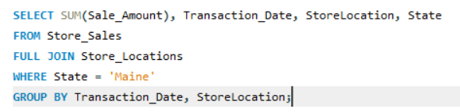
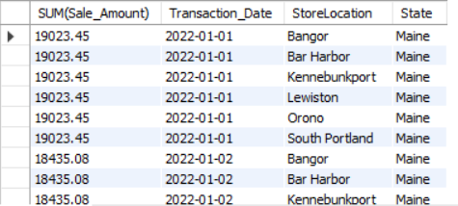
What is total revenue overall for sales in the assigned territory, plus the start date and end date that tell you what period the data covers?
For this, I created a query that analyzes the sale amount by the sales territory. Using the WHERE function combined with the functions of excel, I found the total revenue for sales.

Slide 5
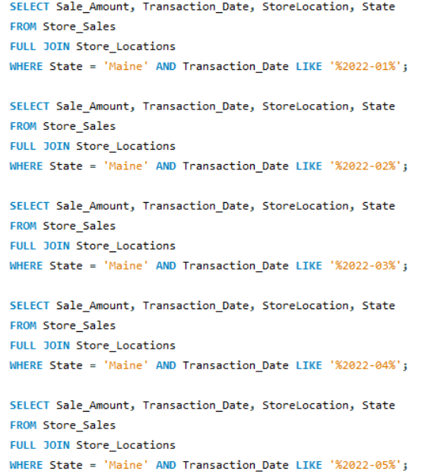
What is the month by month revenue breakdown for the sales territory?
Here, I used a list of queries to summon a result for each month’s sales amount. I took each of the resulting charts and exported them into csv files, and then I was able to put each of them into excel for analysis.

Slide 6
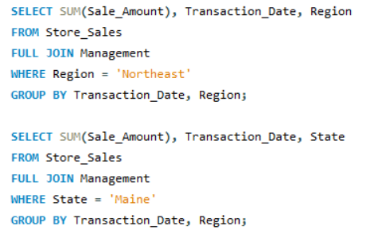
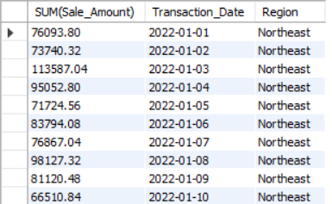
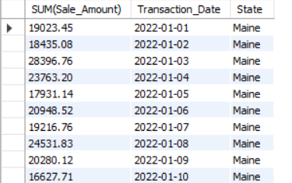
Provide a comparison of total revenue for the specific sales territory and the region it belongs to.
For this task, I used two queries to compare the region and the sales territory (‘Northeast’ and ‘Maine’.)

Slide 7

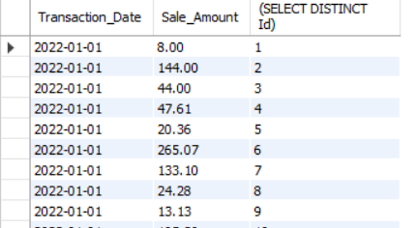
What is the number of transactions per month and average transaction size by product category for the sales territory?
This task was rather difficult for me, in all honesty – finding the number of transactions per month proved to be difficult, and there was no transaction size table to pull from. I was able to find a list of transaction dates and their distinct ids, along with the sale amounts that came with them.

Slide 8
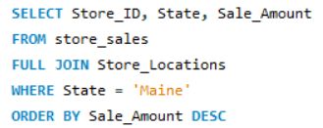
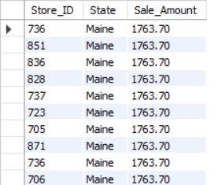
Can you provide a ranking of in-store sales performance by each store in the sales territory, or a ranking of online sales performance by state within an online sales territory?
Using the ORDER BY and DESC function, I provided a ranking of the in-store sales performances from highest to lowest.

Slide 9
What is your recommendation for where to focus sales attention in the next quarter?
-- I would recommend that we focus our sales on the highest performing stores in the region (736, 851, 836, etc).
-- Potentially, we could pour our resources into heightening the sales of lower performing stores (Such as 910 or 903) to help them succeed, but I believe focusing on the most successful stores would be better for long-term customer engagement.

Slide 10
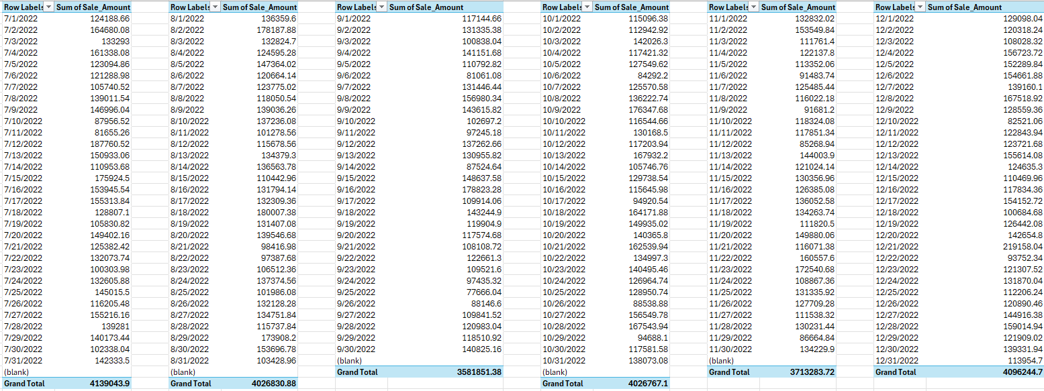
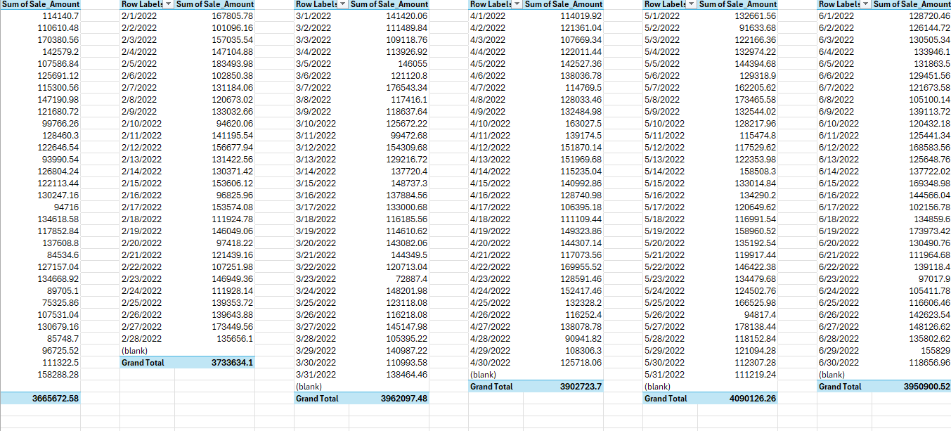
Sales Visualization:
What is total revenue overall for sales in the assigned territory, plus the start date and end date that tell you what period the data covers?

Slide 11
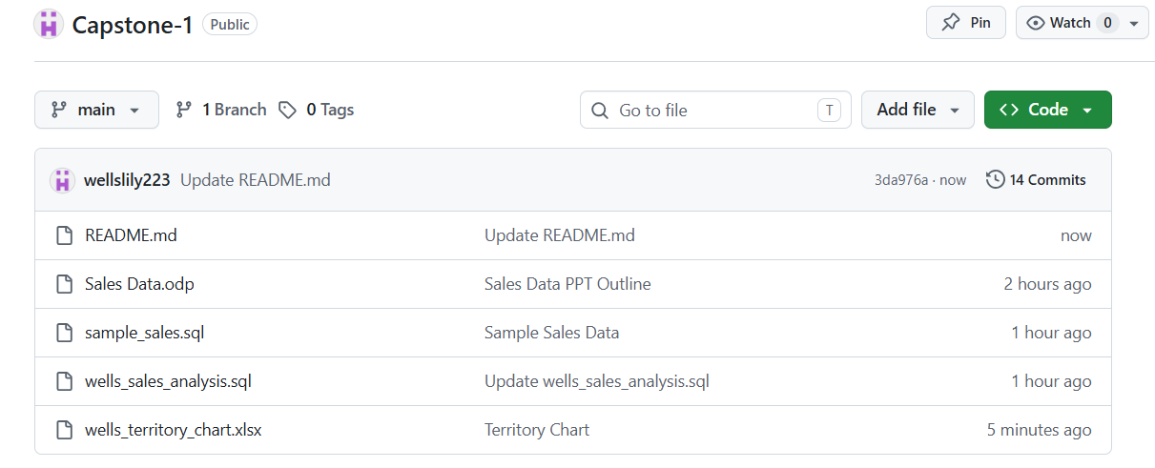
My Github Repository

Slide 12
Thank you for your time!

